Slide 1

LEGO Co. Material requirements planning (MRP)
Name
Institution of Affiliation
Notes:
Greet everyone and let them pay attention
Prepare yourself for the presentation
The company headquarter is based in Billund, Denmark although it has branches worldwide

Slide 2
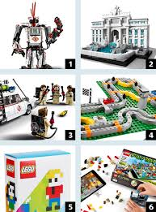
Introduction
LEGO Co. is a children toy and related products manufacturing company that has a production capability to supply products.
As a company, the manufacturing department has the mandate to ensure smooth availability of commodities as required.
LEGO Co. has multiple branches across the world aimed at proper distribution of its products to the customers.
The supply of the raw materials and the final products must be well balanced to ensure that there is no waste (Yamit, 2016).
Notes:
The company has to ensure that production of the commodities meet the demand of the market both quantity wise and quality.
The manufacturing department has to balance production and supply by smooth relations with the rest of the departments such as marketing and supplies chain
The company receives orders from allover the world and it has to meet the demands and expectation of the company

Slide 3
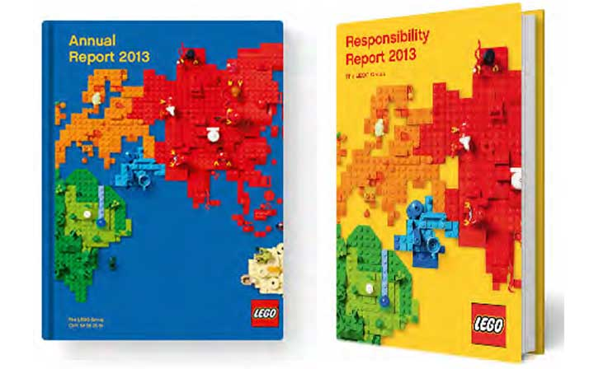
Current Practice---Data Application
Currently, the company relies on the data to estimate the orders that may be placed in a given period.
This means that the company has to rely on the past data and records in the production process.
The manufacturing department has stored data that provides direction and possible pattern of demand and supply of the commodities (Ivanov, Tsipoulanidis & Schönberger, 2017).
The data has to be accurate and applicable at the particular time for better prediction.
Notes:
The company uses data stored for prediction of the orders and demand of the products likely to be placed by the customer.
The data has been accumulated for the company for a long time and follows the dynamics.
The manufacturing department has to rely on other departments for the data such as the supplies management department.
Data mining is something that the company has maintained to ensure trends are well captured so that informed decisions can be made on production.

Slide 4
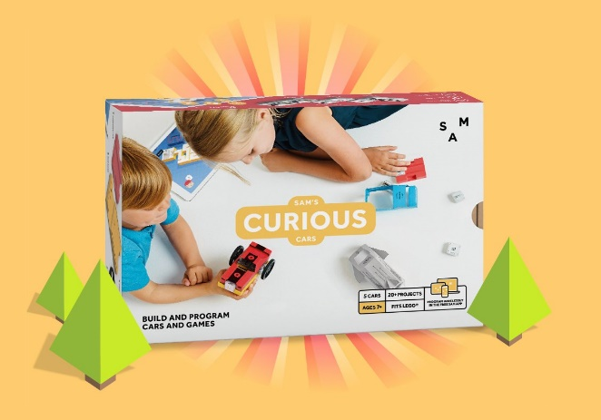
Current Practice—Executive Decisions
The departmental head also makes decisions on production matters.
Depending on his skills and experience he can make decisions regarding the quantity to be produced in a given time (Fleischmann, Meyr & Wagner, 2015).
However, he relies on the data and past experiences and the current trends of the company products.
The decision made is based on the real-time information and statistics that is gathered.
Notes:
The company has delegation form of administration and therefore departmental heads have the authority to make decisions in that particular department.
The decisions made however must be informed and well calculated based on demand and supply
The real-time information is found in the dashboard that provides information concerning all the information about the company production

Slide 5
Current Practice---Mathematical Formulas
The company also uses the mathematical formulas in production to predict the market.
The calculations must be done by qualified personnel in the field of prediction and probability.
However, the calculations must be informed and depended on the market trend and data obtained from the supplies and sales (Ivanov, Tsipoulanidis & Schönberger, 2017).
The calculations are based on the inventory and the supplied products in the market
Notes:
Mathematical calculations are used by the LEGO Co. in the prediction of the production quantity
Most of the calculation are automated based on the inventory and the sales or the orders which has been made
The movement and supply of the already manufactured products provides the data needed in the calculations.

Slide 6
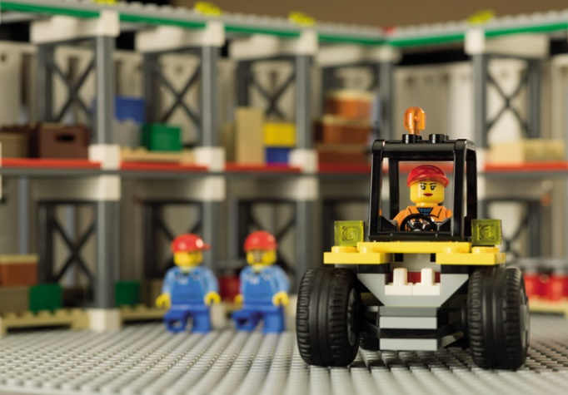
LEGO's MRP improvements
In order for the company to have a proper balance of demand and supply of its products improvement is needed.
The company has to improve on the Material requirements planning (MRP) so that manufacturing distribution is smooth.
Proper MRP guarantees the company proper manufacturing that ensures no wasted of resources and no over or under-production(Yamit, 2016).
The company has options which it can utilize in the management of manufacturing of the children’s toys.
Notes:
For proper functioning of the manufacturing department in the LEGO Company, there is the need to change and improve.
The improvement of the MRP will have a positive impact on the overall production and supply of the commodities to the market
Over estimation or underestimation of products needed is addressed and therefore extra costs such as storage charges are reduced hence increased productivity.

Slide 7
Dependent demand vs independent demand
This MRP is meant to address the waste of resources as production is definite
The materials that are required as exactly what the final product are needed.
The MRP involves both internal and external factors of production before coming up with the decision on the quantity to produce (Yamit, 2016).
This means that the relevant factors both externally and internally are considered and therefore less wastage of raw materials and the final product.
Notes:
Dependent demand entails the factors that are within the company while independent demand are factors that are outside the company
This means that the company has to consider both internal and external factors that actually determines production rate and resources needed in the production process.
Therefore proper inventory, billing and scheduling of production process in achieved.
Low inventory levels and manageable products are supplied and there is no shortage or overproduction.

Slide 8

Outputs
This is production technique that relies on the output of the commodity being manufactured.
It has output 1 and output 2.
The schedules are aimed at ensuring appropriate decisions are made concerning production of the commodity.
The schedule provides timeline needed in the production process and the time to make the supplies to the consumers (Fleischmann, Meyr & Wagner, 2015).
The schedule follow the master production schedule that has overall effect in the company activities.
Notes:
Output MRP is an option that the LEGO company can use in the improvement of the manufacturing process of its products.
The technique involves types 1 and 2 where the type is Recommended Production Schedule and type 2 is Recommended Purchasing Schedule.
Output 1 provides an outline and guide on how and when the production is to take place
Output 2 provides a schedule when the company will take the purchasing role of the resources such as raw materials needed in the manufacture of the product.
All these are geared to ensure that the company meets its obligation and spending little in the costs of operation.

Slide 9
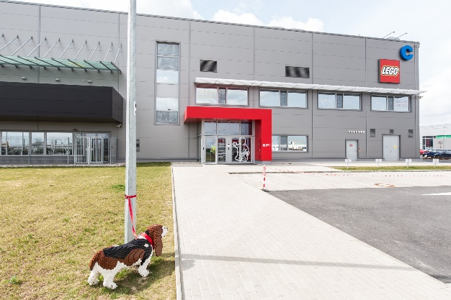
Demand driven MRP
Refers to a technique that promotes production based on the demand of the commodity.
The company is prompted to produce more products due to the demand for such items (Carol, Ptak & Smith, 2016).
The production has strategic inventory positioning where the company produces based on the demand and statistics in the inventory
Buffer profiles and levelling is an important part of the strategy that ensures grouping and matching of materials is possible so that only readily needed resources are purchased for production of the product.
Notes:
The company will benefit from the demand driven MRP where the production is solely dependent on the demand of the final product by the consumer.
The plan has five components which include Strategic inventory positioning, Buffer profiles and level, Dynamic adjustments, Demand-driven planning and Highly visible and collaborative execution.
All the components must be considered when one needs to come up with a production schedule that fits the manufacturing of the company’s product.

Slide 10

References
Carol A.. Ptak, & Smith, C. (2016). Demand Driven Material Requirements Planning: DDMRP. Industrial Press, Incorporated.
Fleischmann, B., Meyr, H., & Wagner, M. (2015). Advanced planning. In Supply chain management and advanced planning (pp. 71-95). Springer, Berlin, Heidelberg.
Ivanov, D., Tsipoulanidis, A., & Schönberger, J. (2017). Production and Material Requirements Planning. In Global Supply Chain and Operations Management (pp. 317-343). Springer, Cham.
Yamit, Z. (2016). Material Requirements Planning Tinjauan tentang Konsep dan Upaya Penerapannya. Unisia, (13), 91-100.
Notes:
Let everyone know that you were grateful for their time.
Take any questions !!!!

